Slide 1


Skill Academy
Data Science with Python Career Program - Capstone Project
By Vipul Dalal

Slide 2

Agenda
Data Exploration
Data insights
Data Cleaning
Exploratory Data Analysis
Model Building
Deployment of ML Model

Slide 3
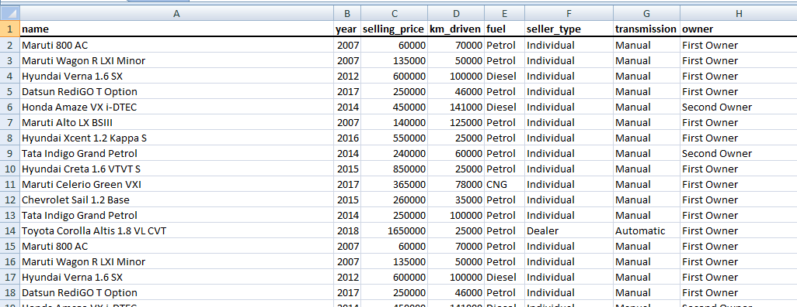
Data Exploration
Skill Academy
The Car Details dataset contains previous selling prices of cars, which includes various parameters such as kilometers driven, year of manufacture, fuel type, type of owner, seller type, and transmission. We will be using advanced statistical and machine learning techniques to analyze the data and build a robust model that can accurately predict the selling price of a car.

Slide 4
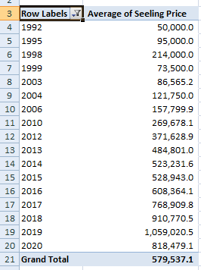
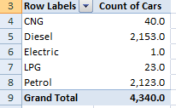
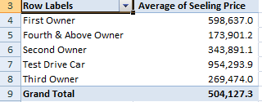
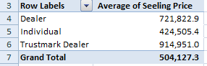
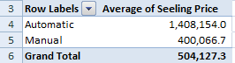
Data Insights
Skill Academy
Our findings showed that automatic cars are priced higher than manual ones. Additionally, cars sold by dealers tend to have a higher price than those sold by individual sellers. The majority of the cars in the dataset were either petrol or diesel-powered. We also discovered that cars with lower kilometers driven and newer cars tend to have a higher price. Lastly, we found that test-drive cars have a slightly higher value compared to others.

Slide 5
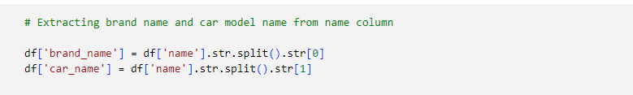
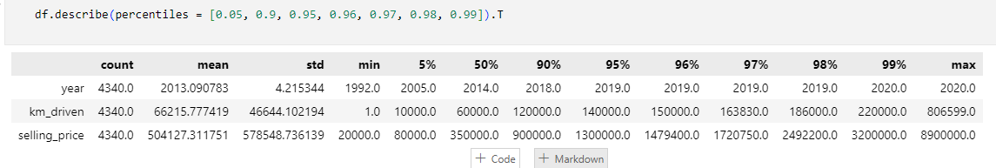
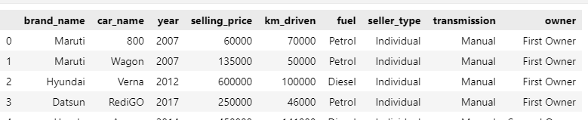
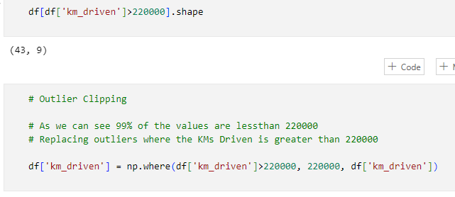
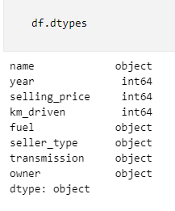
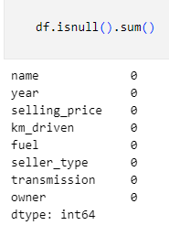
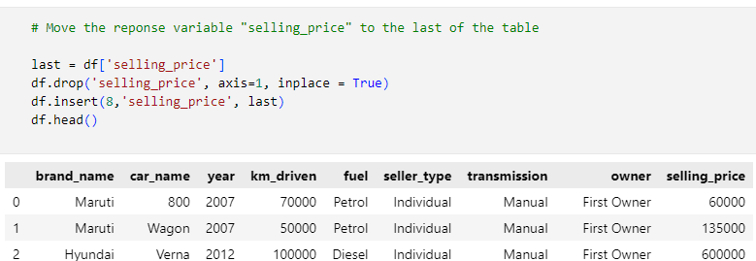
Data Cleaning
Skill Academy
Our data was already in good shape with no missing values and appropriate data types, but we took the additional step of separating the brand name and car name into separate columns for better understanding. We also moved the target variable, the selling price, to the end of the dataset for clearer presentation. Finally, we clipped the outliers on the kilometers driven column to 220000 as 99% of the values were below this threshold. These final modifications will allow us to easily and effectively analyze the data in the following steps of the project.

Slide 6
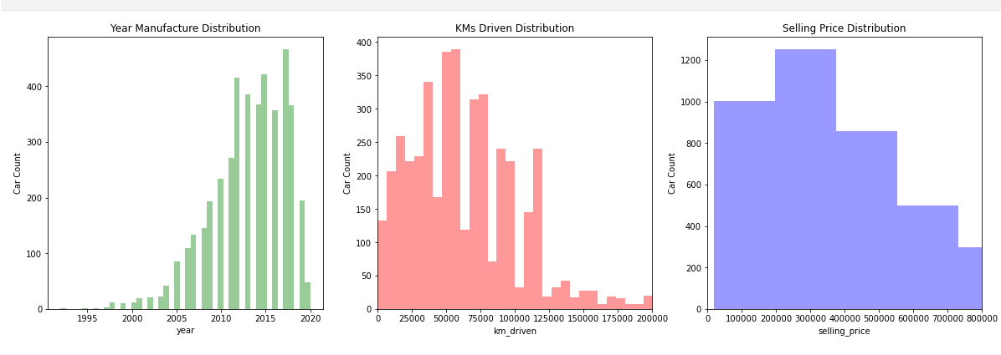
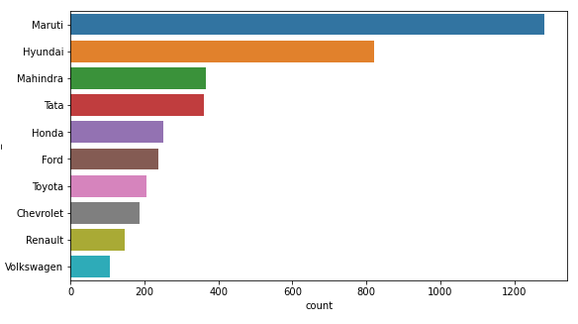
Exploratory Data Analysis
Skill Academy
In the Exploratory Data Analysis (EDA) step of our project, we gained insights into the data through various visualizations. Firstly, we plotted the distribution of continuous columns and observed a large spike in the number of cars manufactured between 2011 and 2018. We also noticed that the graphs for kilometers driven and selling price had a similar unimodal distribution. Moving on, we used countplots to study the distribution of car brands and found that Maruti had the highest number of cars in the dataset.

Slide 7
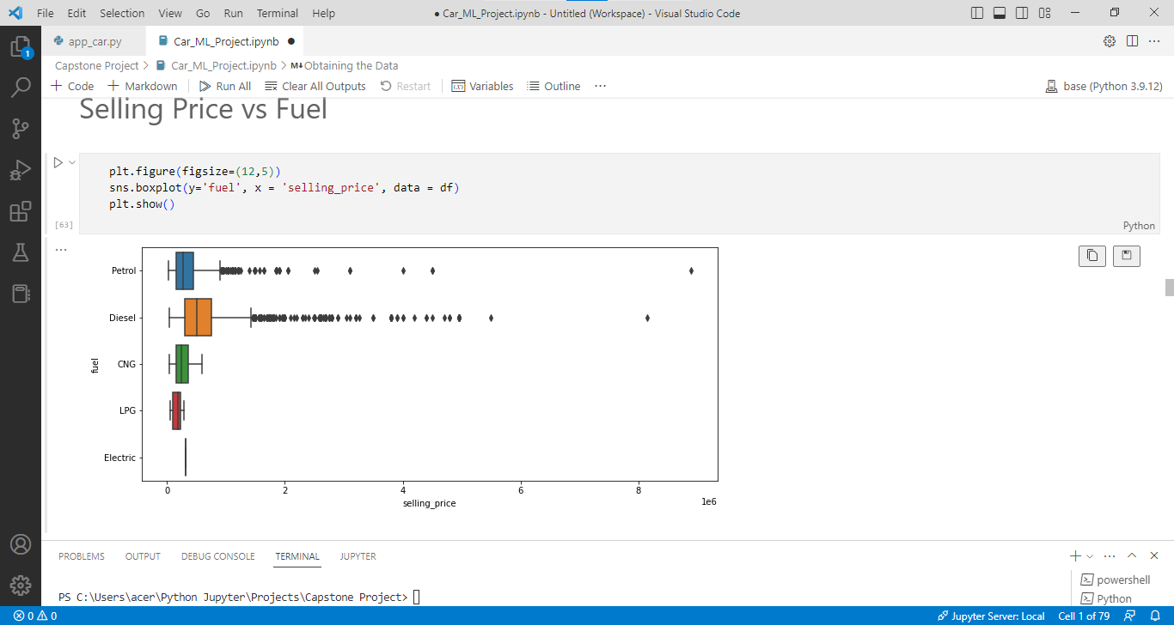
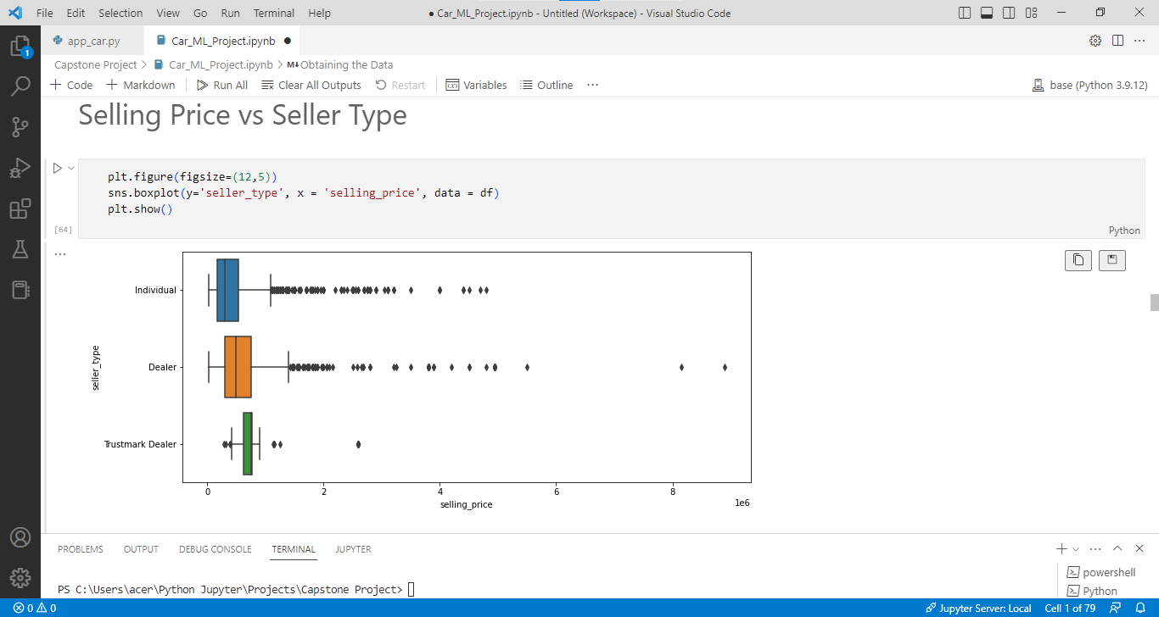
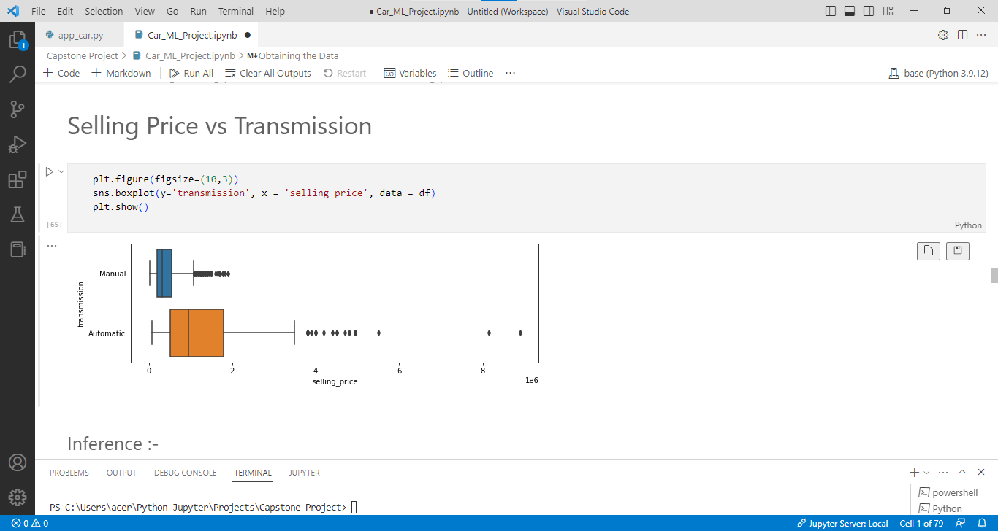
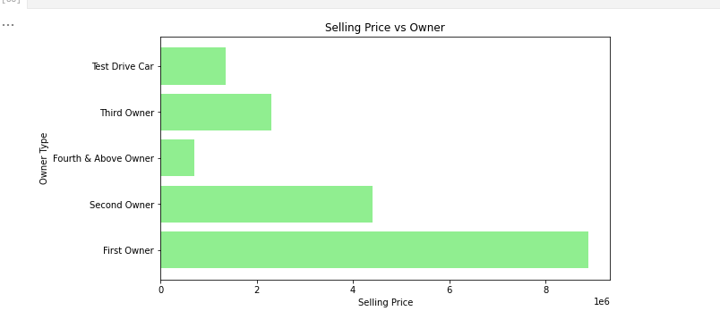
Exploratory Data Analysis
Skill Academy
Furthermore, we compared the selling price with various categorical columns such as fuel type, seller type, transmission, and owner and found that cars with petrol or diesel fuel, sold by dealers, with automatic transmission and owned by the first owner tend to have significantly higher selling prices compared to the rest.

Slide 8
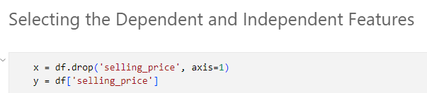
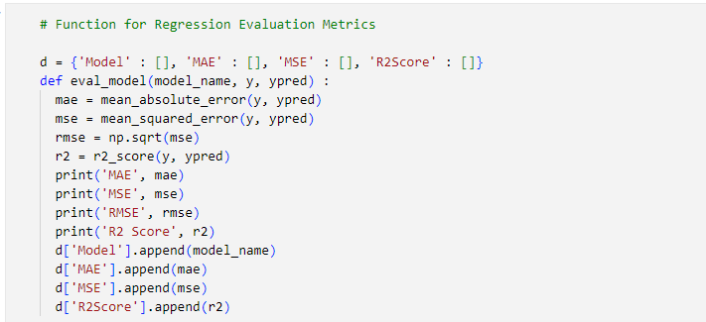
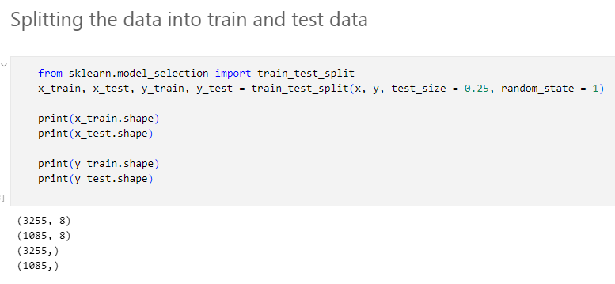
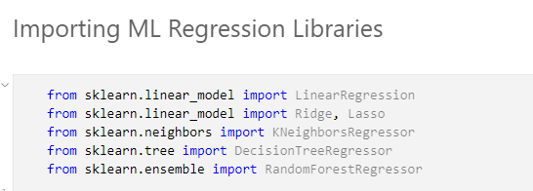
Model Building
Skill Academy
In the Model Building, we used 6 different regression algorithms to predict the selling price of used cars. These algorithms included Linear Regression, Ridge Regression, Lasso Regression, KNeighbors Regressor, Decision Tree Regressor, and Random Forest Regressor. To train these models, we selected the dependent and independent features and split the dataset into training and testing data. We then created a function to evaluate the models based on their Mean Absolute Error, Mean Squared Error, and R2 Score.

Slide 9
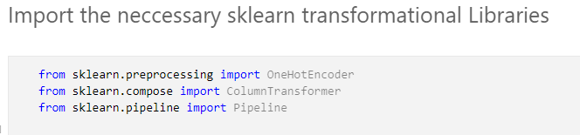
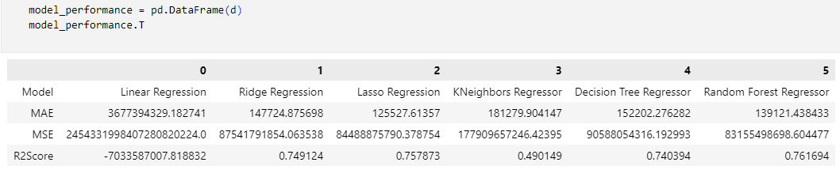
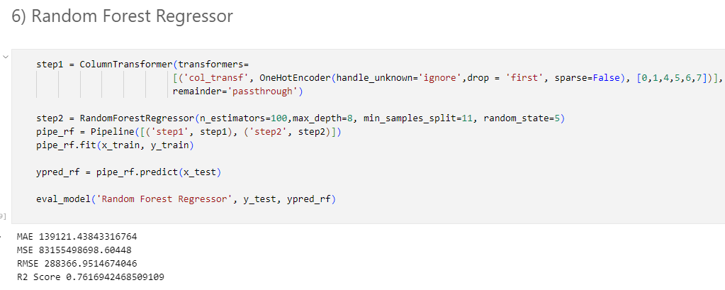
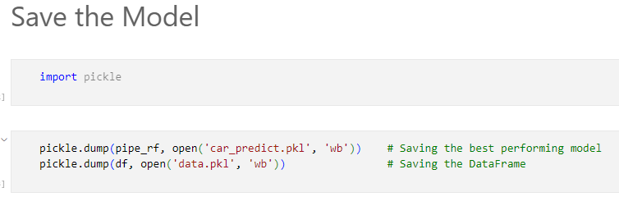
Model Building
Skill Academy
To further improve the performance of our models, we transformed the columns using OneHotEncoding and created a pipeline. After comparing the performance of all models, we concluded that the Random Forest Regressor was the best model with an R2 Score of over 76%. Finally, we saved this model as a binary file using the pickle library for future use.

Slide 10
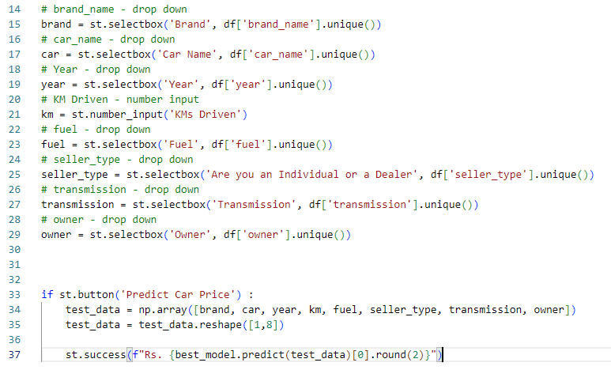
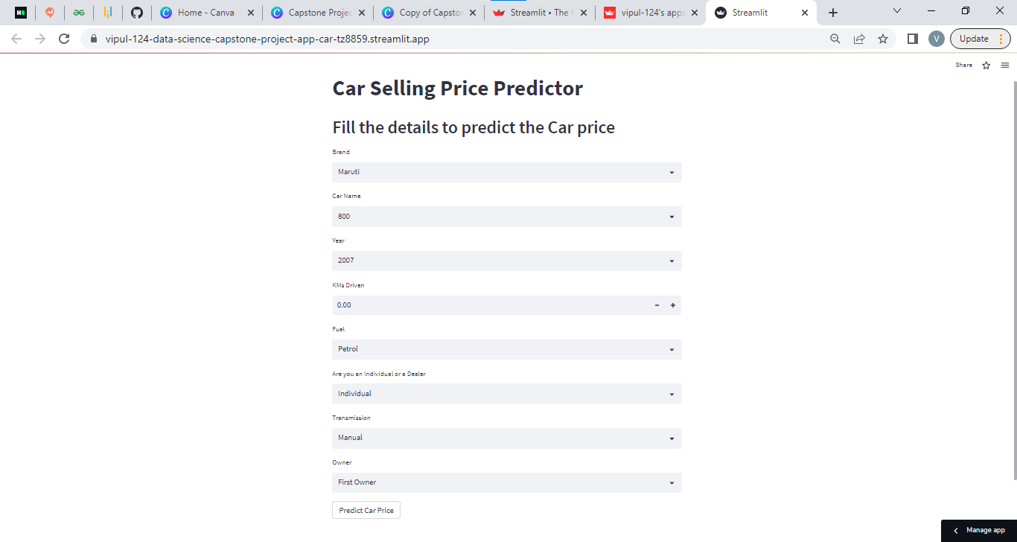
Deployment of ML Model
Skill Academy
In the final step of the project, we created a Streamlit app for predicting the selling price of used cars. We utilized the Streamlit library to build an interactive and user-friendly application that could provide instant predictions based on the input data. The app was titled "Car Selling Price Predictor" and had a user-friendly interface that consisted of selectboxes for 7 columns: brand name, car name, year, fuel type, seller type, transmission, and owner, and a number input for the kilometers driven. After the user inputs the required data, a button was provided to generate the prediction of the car's selling price, which was calculated using the saved machine learning model from the previous step. This Streamlit app was an effective tool that allowed users to easily predict the selling price of used cars and make informed decisions.

Slide 11

Conclusion
In conclusion, this data science project aimed at predicting the selling price of used cars in the second-hand market based on several factors such as the kilometers driven, year, fuel type, owner, seller type, and transmission. Through the various steps of data cleaning, exploratory data analysis, and model building, we were able to build a highly accurate Random Forest Regressor model with an R2 Score of over 76%. The final step of deploying the model into a Streamlit app made it easy for users to access and generate predictions instantly. However, it is important to note that the accuracy of the model could be improved further by incorporating additional information such as the mileage, condition, and other relevant factors. Nevertheless, the results of this project demonstrate the power of machine learning in providing valuable insights and predictions in the second-hand car market.

Slide 12

References
Tools used:- MS Excel, VSCode, Python, Numpy, Pandas, Matplotlib, Seaborn, Scikit Learn, Streamlit.
Git Hub:- https://github.com/Vipul-124/Data-Science-Capstone-Project
Streamlit App:- https://vipul-124-data-science-capstone-project-app-car-tz8859.streamlit.app/

